Slide 1

Copyright © 2011 Pearson Education, Inc. publishing as Prentice Hall
Notes:
Human Resources Management 12e
Gary Dessler
Copyright © 2011 Pearson Education, Inc. publishing as Prentice Hall
7–<number>

Slide 2

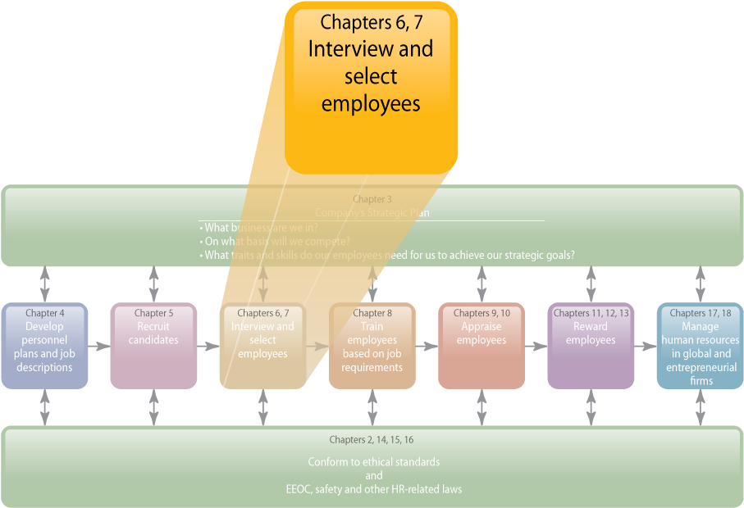
WHERE WE ARE NOW…
Copyright © 2011 Pearson Education, Inc. publishing as Prentice Hall
7–<number>
Notes:
Human Resources Management 12e
Gary Dessler
Copyright © 2011 Pearson Education, Inc. publishing as Prentice Hall
7–<number>
The main topics in this chapter include types of interviews, things that undermine interviewing’s usefulness, and designing and conducting effective selection interviews. If the interview is only one of several selection tools, why devote a whole chapter to this one tool? One answer is that interviews are the most widely used selection procedure.
It would be highly unusual for you not to interview someone before hiring that person. Most interviewers have little or no formal interview training, though they are confident [erroneously] that they can identify the best candidates regardless of the interview structure employed.

Slide 3
LEARNING OUTCOMES
List the main types of selection interviews.
List and explain main errors that can undermine an interview’s usefulness.
Define a structured situational interview.
Explain and illustrate each guideline for being a more effective interviewer.
Give several examples of situational questions, behavioral questions, and background questions that provide structure.
List the steps in a streamlined interview process.
List guidelines for interviewees.
Copyright © 2011 Pearson Education, Inc. publishing as Prentice Hall
7–<number>
Notes:
Human Resources Management 12e
Gary Dessler
Copyright © 2011 Pearson Education, Inc. publishing as Prentice Hall
7–<number>

Slide 4
Basic Types of Interviews
Selection Interview
Types of
Interviews
Appraisal Interview
Exit Interview
Copyright © 2011 Pearson Education, Inc. publishing as Prentice Hall
7–<number>
Notes:
Human Resources Management 12e
Gary Dessler
Copyright © 2011 Pearson Education, Inc. publishing as Prentice Hall
7–<number>
Managers use several interviews at work. For example, an appraisal interview is a discussion, following a performance appraisal, in which supervisor and employee discuss the employee’s ratings and possible remedial actions. When an employee leaves a firm, one often conducts an exit interview. This aims at eliciting information that might provide some insight into what’s right or wrong about the firm. Many techniques in this chapter apply to appraisal and exit interviews. However, we’ll postpone a fuller discussion of these two interviews until Chapters 9 and 10 and focus here on selection interviews.

Slide 5
Selection Interview Structure
Selection Interview Characteristics
Interview
structure
Interview
content
Interview administration
Copyright © 2011 Pearson Education, Inc. publishing as Prentice Hall
7–<number>
Notes:
Human Resources Management 12e
Gary Dessler
Copyright © 2011 Pearson Education, Inc. publishing as Prentice Hall
7–<number>
We can classify selection interviews according to:
1. How structured they are
2. Their “content”—the types of questions they contain
3. How the firm administers the interviews

Slide 6
Selection Interview Formats
Interview Structure Formats
Unstructured (nondirective) interview
Structured
(directive)
interview
Copyright © 2011 Pearson Education, Inc. publishing as Prentice Hall
7–<number>
Notes:
Human Resources Management 12e
Gary Dessler
Copyright © 2011 Pearson Education, Inc. publishing as Prentice Hall
7–<number>
In unstructured (or nondirective) interviews, the manager follows no set format. A few questions might be specified in advance. Most selection interviews fall in this category.
In structured (or directive) interviews, the employer lists job-oriented questions ahead of time, and possible predetermined answers for appropriateness and scoring.

Slide 7
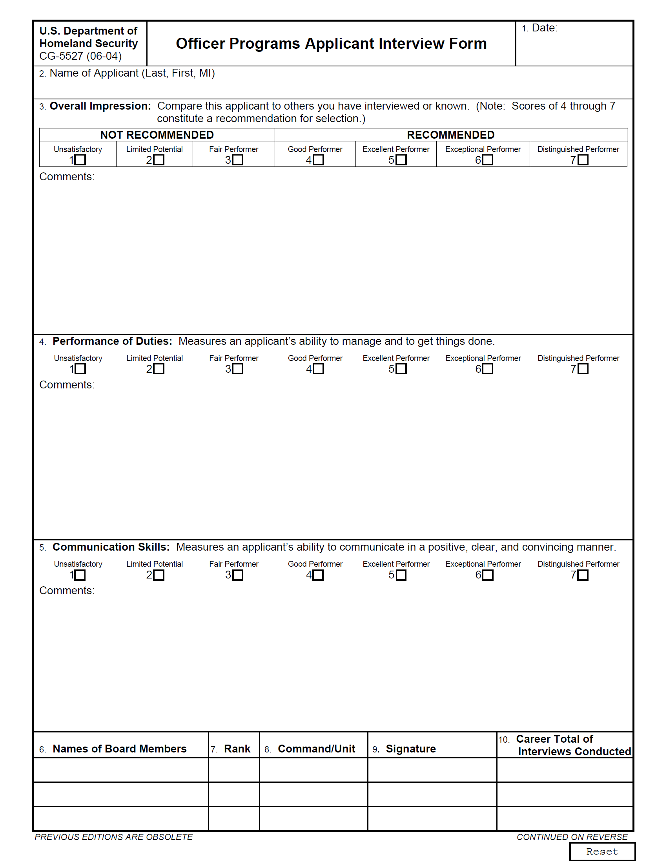
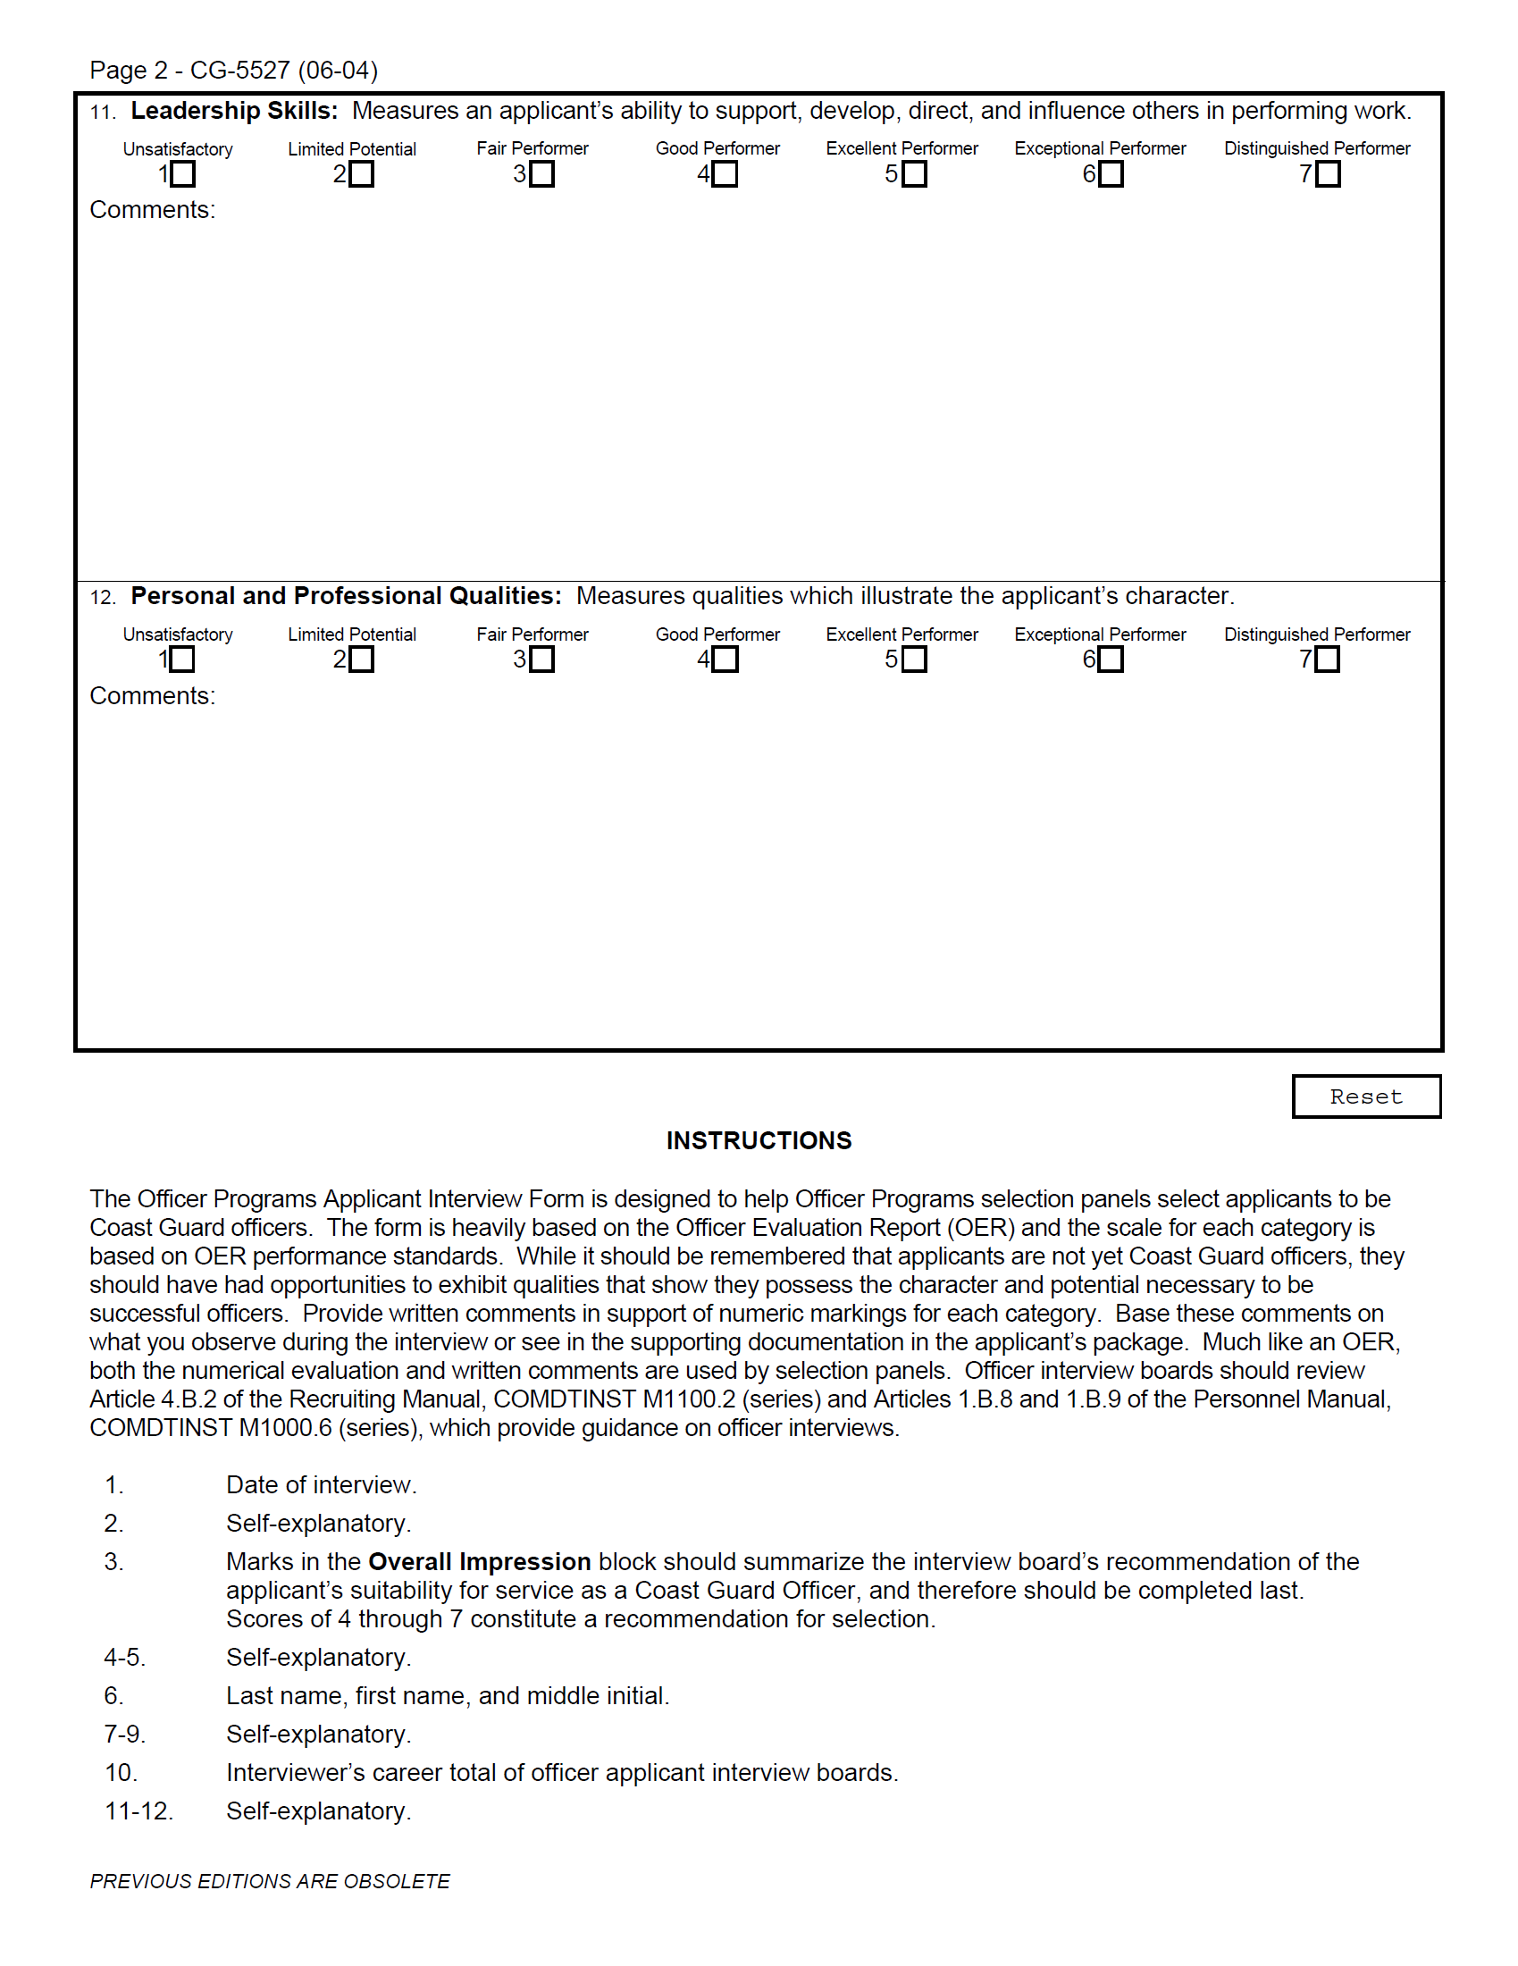
FIGURE 7–1 Officer Programs Applicant Interview Form
Copyright © 2011 Pearson Education, Inc. publishing as Prentice Hall
7–<number>
Notes:
Human Resources Management 12e
Gary Dessler
Copyright © 2011 Pearson Education, Inc. publishing as Prentice Hall
7–<number>
The Department of Homeland Security uses the structured guide in Figure 7-1 to help screen Coast Guard officer candidates. It contains a formal candidate rating procedure; it also enables geographically disbursed interviewers to complete the form over the Web.

Slide 8
EEOC Aspects of Interviews
Use objective/job-related questions
Avoiding Discrimination in Interviews
Standardize interview administration
Use multiple interviewers
Copyright © 2011 Pearson Education, Inc. publishing as Prentice Hall
7–<number>
Notes:
Human Resources Management 12e
Gary Dessler
Copyright © 2011 Pearson Education, Inc. publishing as Prentice Hall
7–<number>
A study of federal district court cases involving alleged employment interview discrimination indicates that the courts will look at whether the interview process is structured and consistently applied.

Slide 9
Interview Content
Types of Questions Asked
Situational interview
Behavioral interview
Job-related interview
Stress
interview
Copyright © 2011 Pearson Education, Inc. publishing as Prentice Hall
7–<number>
Notes:
Human Resources Management 12e
Gary Dessler
Copyright © 2011 Pearson Education, Inc. publishing as Prentice Hall
7–<number>
We can also classify interviews based on the “content” or the types of questions asked in the interview. At work, situational, behavioral, and job-related questions are most important.

Slide 10
Administering the Interview
Unstructured sequential interview
Structured sequential interview
Panel
interview
Ways in Which Interview Can be Conducted
Mass
interview
Phone
interviews
Computerized interviews
Video/Web-assisted interviews
Copyright © 2011 Pearson Education, Inc. publishing as Prentice Hall
7–<number>
Notes:
Human Resources Management 12e
Gary Dessler
Copyright © 2011 Pearson Education, Inc. publishing as Prentice Hall
7–<number>
Employers also administer interviews in various ways: one-on-one or by a panel of interviewers; sequentially or all at once; and computerized or personally.

Slide 11
Three Ways to Make the Interview Useful
Structure the interview to increase its validity
Making the Interview Useful
Carefully choose what sorts of traits are to be assessed
Beware of committing interviewing errors
Copyright © 2011 Pearson Education, Inc. publishing as Prentice Hall
7–<number>
Notes:
Human Resources Management 12e
Gary Dessler
Copyright © 2011 Pearson Education, Inc. publishing as Prentice Hall
7–<number>
The interview holds an ironic place in the hiring process: If done poorly, it’s generally not too useful. If done properly, then the interview can be a much better predictor of performance than previously thought and is comparable with many other selection techniques.

Slide 12
What Can Undermine An Interview’s Usefulness?
First impressions (snap judgments)
Nonverbal behavior and impression management
Factors Affecting An Interview’s Usefulness
Interviewer’s
misunderstanding
of the job
Applicant’s personal characteristics
Candidate-order (contrast) error and pressure to hire
Interviewer’s inadvertent behavior
Copyright © 2011 Pearson Education, Inc. publishing as Prentice Hall
7–<number>
Notes:
Human Resources Management 12e
Gary Dessler
Copyright © 2011 Pearson Education, Inc. publishing as Prentice Hall
7–<number>
This slide summarizes potential interviewing errors to avoid:
• First impressions (snap judgments)
• Not clarifying what the job involves and requires
• Candidate-order error and pressure to hire
• Nonverbal behavior and impression management
• The effects of interviewees’ personal characteristics
• The interviewer’s inadvertent behavior

Slide 13
How to Design and Conduct
An Effective Interview
The Structured Situational Interview
  Use either situational questions or behavioral questions that yield high criteria-related validities.
    Step 1: Analyze the job.
    Step 2: Rate the job’s main duties.
    Step 3: Create interview questions.
    Step 4: Create benchmark answers.
    Step 5: Appoint the interview panel and conduct interviews.
Copyright © 2011 Pearson Education, Inc. publishing as Prentice Hall
7–<number>
Notes:
Human Resources Management 12e
Gary Dessler
Copyright © 2011 Pearson Education, Inc. publishing as Prentice Hall
7–<number>
In creating structured situational interviews, people familiar with the job develop questions based on the job’s actual duties. They then reach consensus on what are and are not acceptable answers. The procedure is as outline in this slide.

Slide 14
How to Conduct a More Effective Interview
Being Systematic and Effective
1
Know the job.
2
Structure the interview.
3
Get organized.
4
Establish rapport.
5
Ask questions.
6
Take brief, unobtrusive notes.
7
Close the interview.
8
Review the interview.
Copyright © 2011 Pearson Education, Inc. publishing as Prentice Hall
7–<number>
Notes:
Human Resources Management 12e
Gary Dessler
Copyright © 2011 Pearson Education, Inc. publishing as Prentice Hall
7–<number>
You may not have the time or inclination to create a full-blown, structured situational interview. However, there is still a lot you can do to make your interviews more systematic and effective.

Slide 15
Creating Effective Interview Structures
Base questions on actual job duties.
Use job knowledge, situational or behavioral questions, and objective criteria to evaluate interviewee’s responses.
Use the same questions with all candidates.
Use descriptive rating scales (excellent, fair, poor) to rate answers.
If possible, use a standardized interview form.
Copyright © 2011 Pearson Education, Inc. publishing as Prentice Hall
7–<number>
Notes:
Human Resources Management 12e
Gary Dessler
Copyright © 2011 Pearson Education, Inc. publishing as Prentice Hall
7–<number>
Any structuring is usually better than none. If pressed for time, you can do several things to ask more consistent and job-relevant questions, without developing a full-blown structured interview.

Slide 16
FIGURE 7–2 Examples of Questions That Provide Structure
Situational Questions
1. Suppose a more experienced coworker was not following standard work procedures and claimed the new procedure was better. Would you use the new procedure?
2. Suppose you were giving a sales presentation and a difficult technical question arose that you could not answer. What would you do?
Past Behavior Questions
3. Based on your past work experience, what is the most significant action you have ever taken to help out a coworker?
4. Can you provide an example of a specific instance where you developed a sales presentation that was highly effective?
Background Questions
5. What work experiences, training, or other qualifications do you have for working in a teamwork environment?
6. What experience have you had with direct point-of-purchase sales?
Job Knowledge Questions
7. What steps would you follow to conduct a brainstorming session with a group of employees on safety?
8. What factors should you consider when developing a television advertising campaign?
Copyright © 2011 Pearson Education, Inc. publishing as Prentice Hall
7–<number>
Notes:
Human Resources Management 12e
Gary Dessler
Copyright © 2011 Pearson Education, Inc. publishing as Prentice Hall
7–<number>
Figure 7-2 illustrates several examples of structured job knowledge, situational, background or behavioral interview questions.

Slide 17
FIGURE 7–3 Suggested Supplementary Questions for Interviewing Applicants
How did you choose this line of work?
What did you enjoy most about your last job?
What did you like least about your last job?
What has been your greatest frustration or disappointment on your present job? Why?
What are some of the pluses and minuses of your last job?
What were the circumstances surrounding your leaving your last job?
Did you give notice?
Why should we be hiring you?
What do you expect from this employer?
What are three things you will not do in your next job?
What would your last supervisor say your three weaknesses are?
What are your major strengths?
How can your supervisor best help you obtain your goals?
How did your supervisor rate your job performance?
In what ways would you change your last supervisor?
What are your career goals during the next 1–3 years? 5–10 years?
How will working for this company help you reach those goals?
What did you do the last time you received instructions with which you disagreed?
What are some things about which you and your supervisor disagreed? What did you do?
Which do you prefer, working alone or working with groups?
What motivated you to do better at your last job?
Do you consider your progress in that job representative of your ability? Why?
Do you have any questions about the duties of the job for which you have applied?
Can you perform the essential functions of the job for which you have applied?
Copyright © 2011 Pearson Education, Inc. publishing as Prentice Hall
7–<number>
Notes:
Human Resources Management 12e
Gary Dessler
Copyright © 2011 Pearson Education, Inc. publishing as Prentice Hall
7–<number>
Figure 7-3 contains a sampling of technical questions to be asked in interviews.

Slide 18

Using a Streamlined Interview Process
Prepare for the interview
  Knowledge and experience
  Motivation
  Intellectual capacity
  Personality factor
Formulate questions to ask
in the interview
  Intellectual factor
  Motivation factor
  Personality factor
  Knowledge and experience factor
Conduct the interview
  Have a plan
  Follow your plan
Match the candidate to the job
Copyright © 2011 Pearson Education, Inc. publishing as Prentice Hall
7–<number>
Notes:
Human Resources Management 12e
Gary Dessler
Copyright © 2011 Pearson Education, Inc. publishing as Prentice Hall
7–<number>
Managers are busy people who may not always have the time or inclination to follow all of the interview steps suggested thus far. If so, here, from one employment expert, is a streamlined approach that may come in handy.

Slide 19
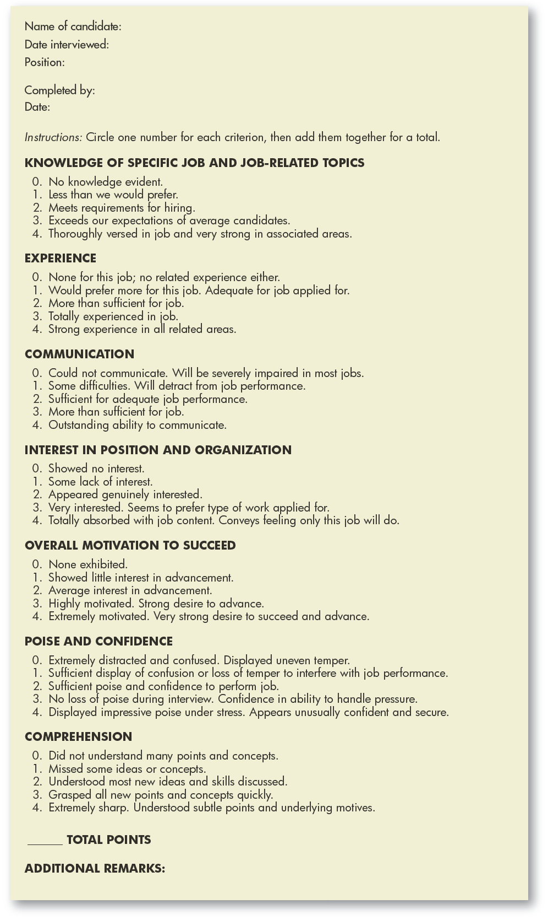
FIGURE 7–4
Interview Evaluation
Form
Copyright © 2011 Pearson Education, Inc. publishing as Prentice Hall
7–<number>
Notes:
Human Resources Management 12e
Gary Dessler
Copyright © 2011 Pearson Education, Inc. publishing as Prentice Hall
7–<number>
A manager can use an interview evaluation form such as the one in Figure 7-4 to compile his or her impressions of an applicant.

Slide 20
Guidelines for Interviewees
Preparation is essential.
Uncover the interviewer’s real needs.
Relate yourself to the interviewer’s needs.
Think before answering.
Remember that appearance and enthusiasm are important.
Make a good first impression.
Ask questions.
Copyright © 2011 Pearson Education, Inc. publishing as Prentice Hall
7–<number>
Notes:
Human Resources Management 12e
Gary Dessler
Copyright © 2011 Pearson Education, Inc. publishing as Prentice Hall
7–<number>
Before you get into a position where you have to interview others, you will probably have to navigate some interviews yourself. It’s therefore useful to apply these guidelines to navigating your own interviews.

Slide 21
FIGURE 7–5 Interview Questions to Ask
What is the first problem that needs the attention of the person you hire?
What other problems need attention now?
What has been done about any of these to date?
How has this job been performed in the past?
Why is it now vacant?
Do you have a written job description for this position?
What are its major responsibilities?
What authority would I have? How would you define its scope?
What are the company’s five-year sales and profit projections?
What needs to be done to reach these projections?
What are the company’s major strengths and weaknesses?
What are its strengths and weaknesses in production?
What are its strengths and weaknesses in its products or its competitive position?
Whom do you identify as your major competitors?
What are their strengths and weaknesses?
How do you view the future for your industry?
Do you have any plans for new products or acquisitions?
Might this company be sold or acquired?
What is the company’s current financial strength?
What can you tell me about the individual to whom I would report?
What can you tell me about other persons in key positions?
What can you tell me about the subordinates I would have?
How would you define your management philosophy?
Are employees afforded an opportunity for continuing education?
What are you looking for in the person who will fill this job?
Copyright © 2011 Pearson Education, Inc. publishing as Prentice Hall
7–<number>
Notes:
Human Resources Management 12e
Gary Dessler
Copyright © 2011 Pearson Education, Inc. publishing as Prentice Hall
7–<number>
Sample questions that interviewees may wish to ask during interviews are presented in Figure 7-5.

Slide 22
K E Y T E R M S
unstructured (or nondirective) interview
structured (or directive) interview
situational interview
behavioral interview
job-related interview
stress interview
unstructured sequential interview
structured sequential interview
panel interview
mass interview
candidate-order error (or contrast) error
structured situational interview
Copyright © 2011 Pearson Education, Inc. publishing as Prentice Hall
7–<number>
Notes:
Human Resources Management 12e
Gary Dessler
Copyright © 2011 Pearson Education, Inc. publishing as Prentice Hall
7–<number>

Slide 23
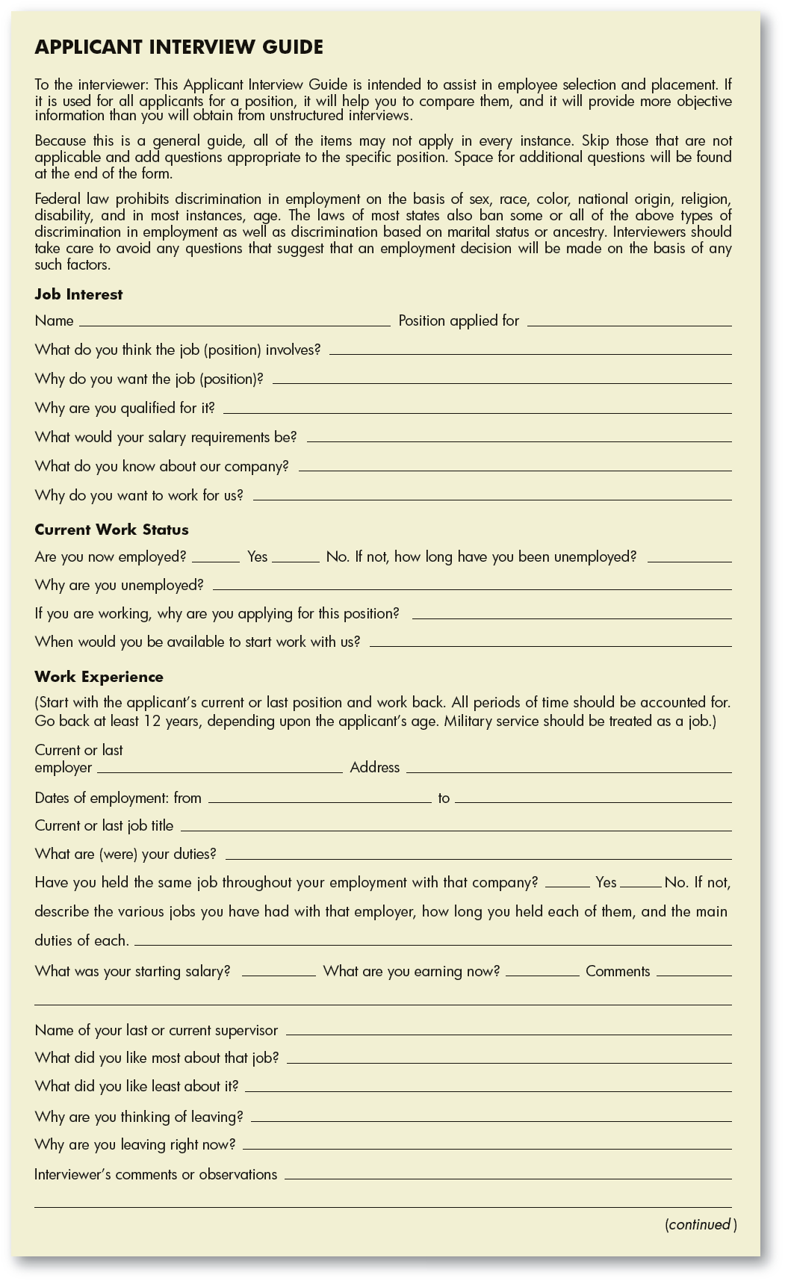
FIGURE 7–A1
Structured Interview Guide
Copyright © 2011 Pearson Education, Inc. publishing as Prentice Hall
7–<number>
Notes:
Human Resources Management 12e
Gary Dessler
Copyright © 2011 Pearson Education, Inc. publishing as Prentice Hall
7–<number>

Slide 24
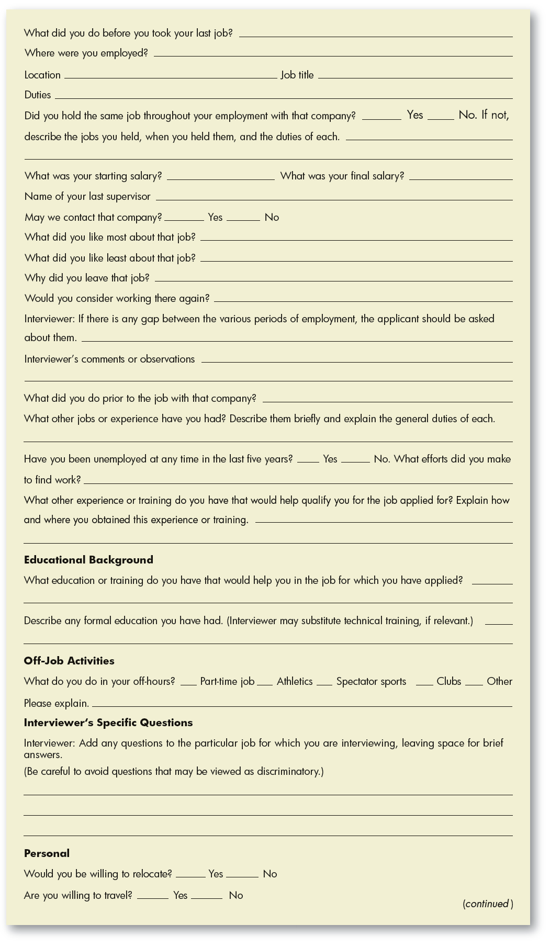
FIGURE 7–A1
Structured Interview Guide (cont’d)
Copyright © 2011 Pearson Education, Inc. publishing as Prentice Hall
7–<number>
Notes:
Human Resources Management 12e
Gary Dessler
Copyright © 2011 Pearson Education, Inc. publishing as Prentice Hall
7–<number>

Slide 25
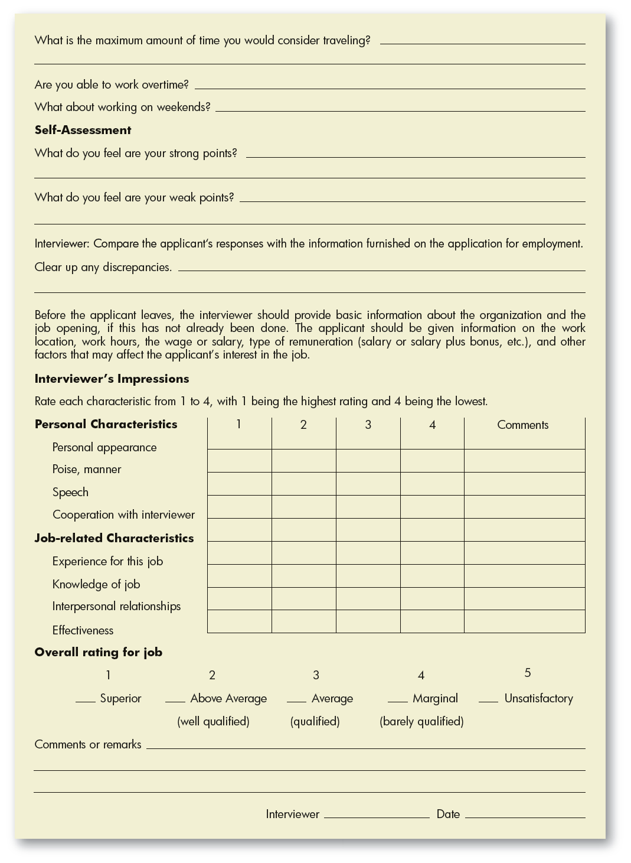
FIGURE 7–A1
Structured Interview Guide (cont’d)
Copyright © 2011 Pearson Education, Inc. publishing as Prentice Hall
7–<number>
Notes:
Human Resources Management 12e
Gary Dessler
Copyright © 2011 Pearson Education, Inc. publishing as Prentice Hall
7–<number>

Slide 26

All rights reserved. No part of this publication may be reproduced, stored in a retrieval system, or transmitted, in any form or by any means, electronic, mechanical, photocopying, recording, or otherwise, without the prior written permission of the publisher. Printed in the United States of America.
Copyright © 2011 Pearson Education, Inc. publishing as Prentice Hall
7–<number>
Notes:
Human Resources Management 12e
Gary Dessler
Copyright © 2011 Pearson Education, Inc. publishing as Prentice Hall
7–<number>

